Slide 1











Decarbonising the Residential Heating in the North of Tyne (NoT)
Integrating Social Interventions and Low-Carbon Technologies
Mohamed Abuella and Adib Allahham

Slide 2
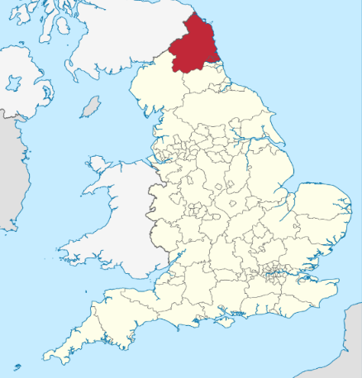
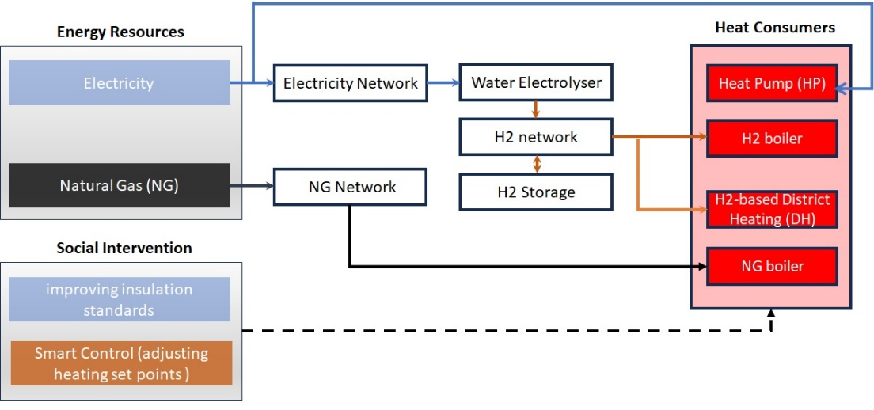
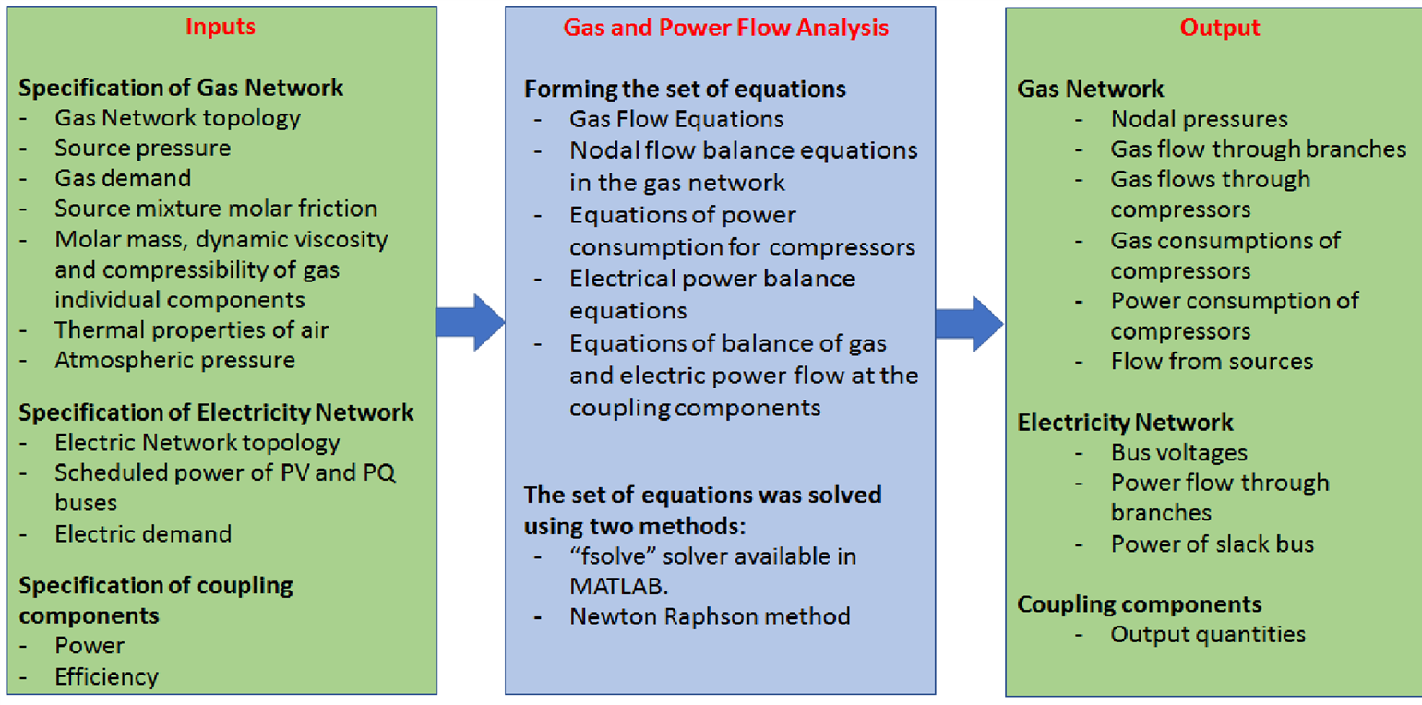
Heat Decarbonisation: North of Tyne (NoT)
Objective:
Assessment of the impacts of social and technical interventions for the decarbonisation of residential heating on the electricity and gas systems in the North of Tyne (NoT) region.
Key Questions:
What are the impacts of social and technical interventions on system performance?
What is the economic dispatch and associated CO2 emissions of the heating interventions?
What are the impacts heat pumps and hydrogen boilers at different intervention levels?
What are the impacts of the combined interventions of heat pumps and hydrogen boilers?
What is economic plan of one-day heating interventions for the years 2025-2050?
What is the plan for combined heat pumps and hydrogen boilers with CCS over 2025-2050?
What are the requirements/impacts for hydrogen blending into the existing gas network?
High-level diagram of resources-technology model
Schematic Diagram of Modelling

Slide 3
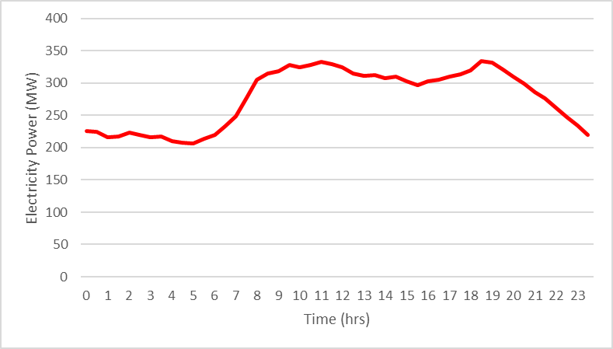
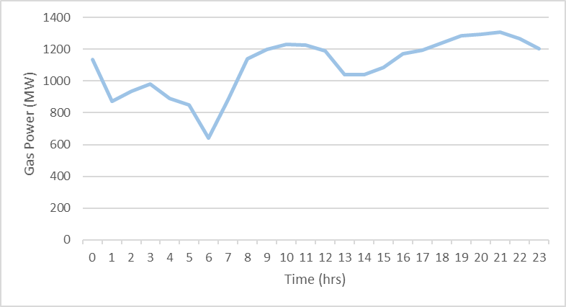
Heat Decarbonisation: North of Tyne (NoT)
Demand Overview
The heating scenarios use the coldest day in November 2019 as a baseline to model peak energy demand.
Total energy demand reached 31 GWh, with gas consumption (24 GWh) significantly outpacing electricity (7 GWh).
Daily domestic demand averaged 16.6 GWh (12.45 GWh for gas, 4.15 GWh for electricity).
Daily Profile of Total Electricity Demand for NoT in 2019
Daily Profile of Total Gas Demand for NoT in 2019

Slide 4
Heat Decarbonisation: North of Tyne (NoT)
Social Intervention Scenarios
The heat decarbonisation scenarios evaluate how social-based interventions impact electricity and gas networks and the broader energy system within the North of Tyne (NoT) region.
Developed to address decarbonisation needs, these scenarios model various heating interventions affecting 10% of households.
Scenario Formulation of Socio-Technical Interventions of Residential Heating in NoT
Scenario | Intervention | Effect on Gas Demand | Effect on Electricity Demand
1 | Decreasing the heating set point by 2°C | 20% decrease | No effect
2 | Improving the whole building insulation level similar to Passivhaus standards | 77% decrease | No effect
3 | Delay start of heating from October to November | 5.5% decrease | No effect
4 | Use of radiator valves to turn off heating in unoccupied rooms | 4% decrease | No effect
5 | Use of heat pumps | 21.3 % decrease | 7.1% increase
6 | Use of hydrogen boilers | 10% decrease | No effect

Slide 5
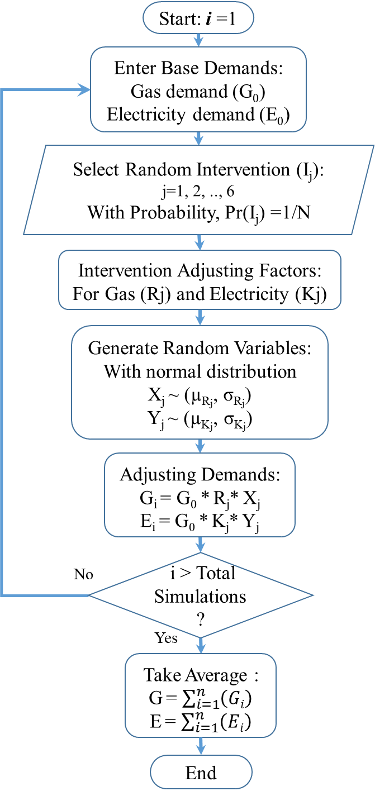
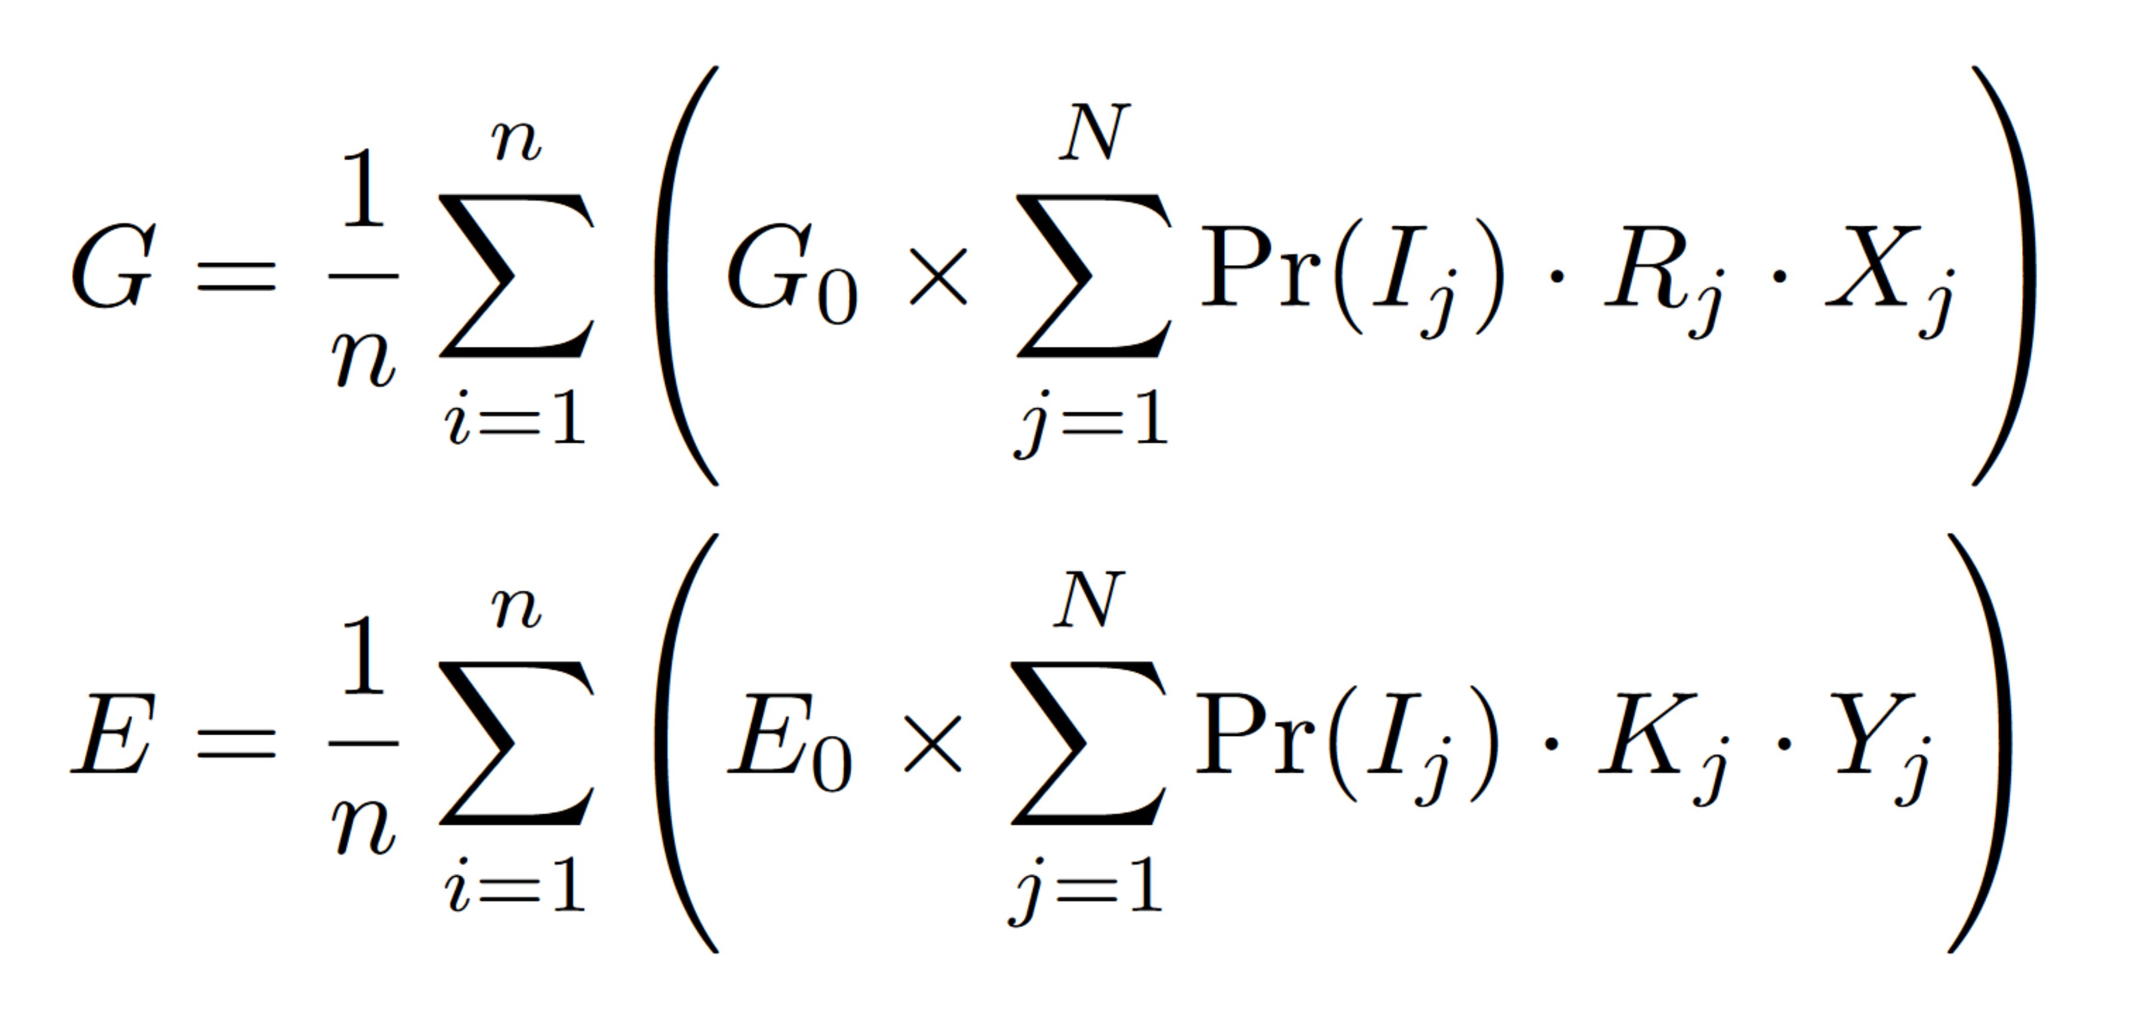
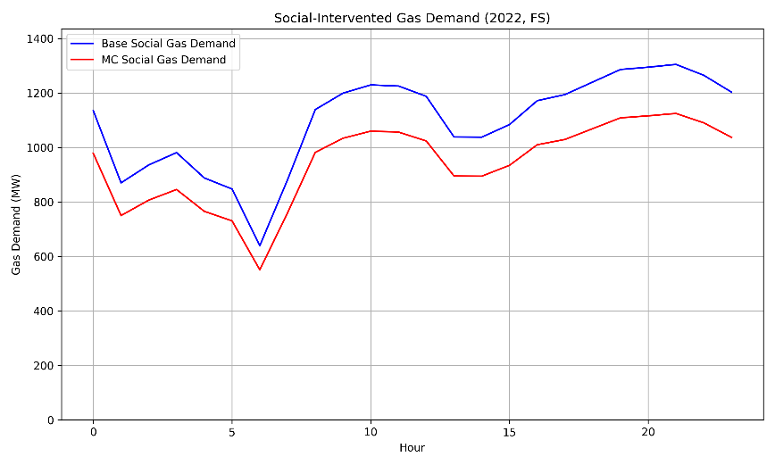
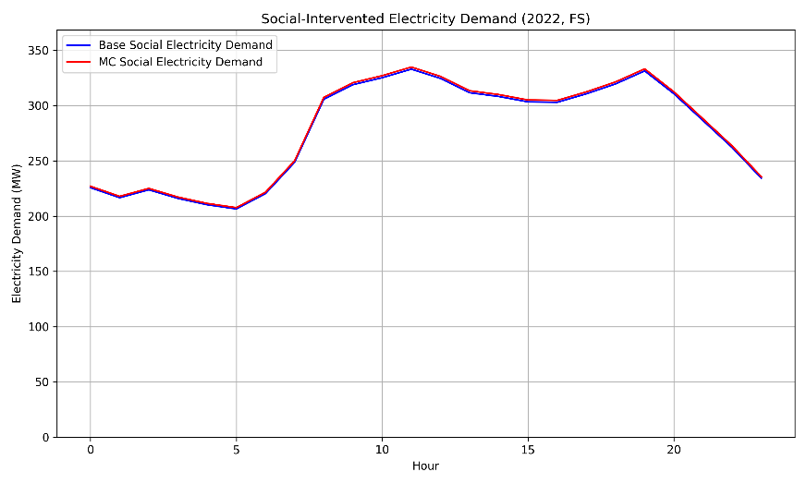
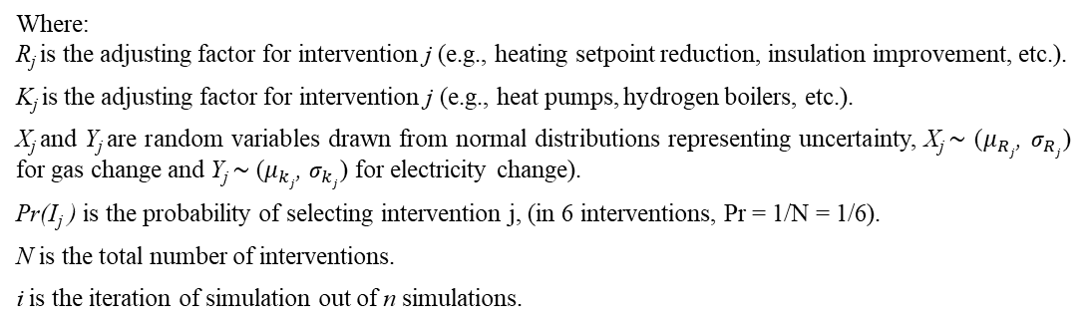
Heat Decarbonisation: North of Tyne (NoT)
Modelling Social-Technical Interventions Scenarios by Monte Carlo Simulation
Let G₀ and E₀ represent the baseline gas and electricity demands, respectively. The adjusted demands G and E after applying a random intervention I_{j} .
Gas Demand
Where: R_{j} is the adjusting factor for intervention j (e.g., heating setpoint reduction, insulation improvement, etc.).
K_{j} is the adjusting factor for intervention j (e.g., heat pumps, hydrogen boilers, etc.).
X_{j} and Y_{j} are random variables drawn from normal distributions representing uncertainty, X_{j} ∼ ($μ_{Rj}$, ${\text{σ}}_{Rj}$) for gas change and Y_{j} ∼ ($μ_{kj}$, ${\text{σ}}_{kj}$) for electricity change).
Pr(I_{j} ) is the probability of selecting intervention j, (in 6 interventions, Pr = 1/N = 1/6).
N is the total number of interventions.
i is the iteration of simulation out of n simulations.
Electricity Demand
The Monte Carlo simulation of heating interventions indicates a noticeable reduction in gas demand, with only a marginal increase in electricity demand.
Monte Carlo Simulation for Social and Technical Interventions of Heating Demand

Slide 6
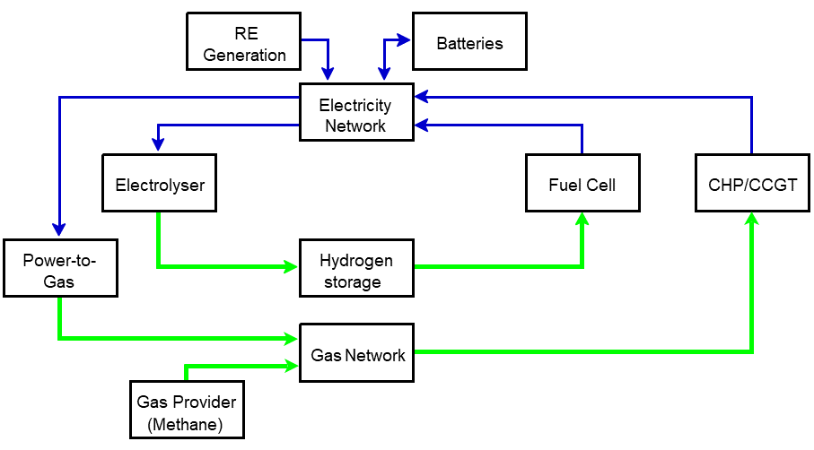
Heat Decarbonisation: North of Tyne (NoT)
System Data
Energy Generation, Coupling and Storage
General and Economic Parameters of the Energy System
Interaction within the energy system

Slide 7
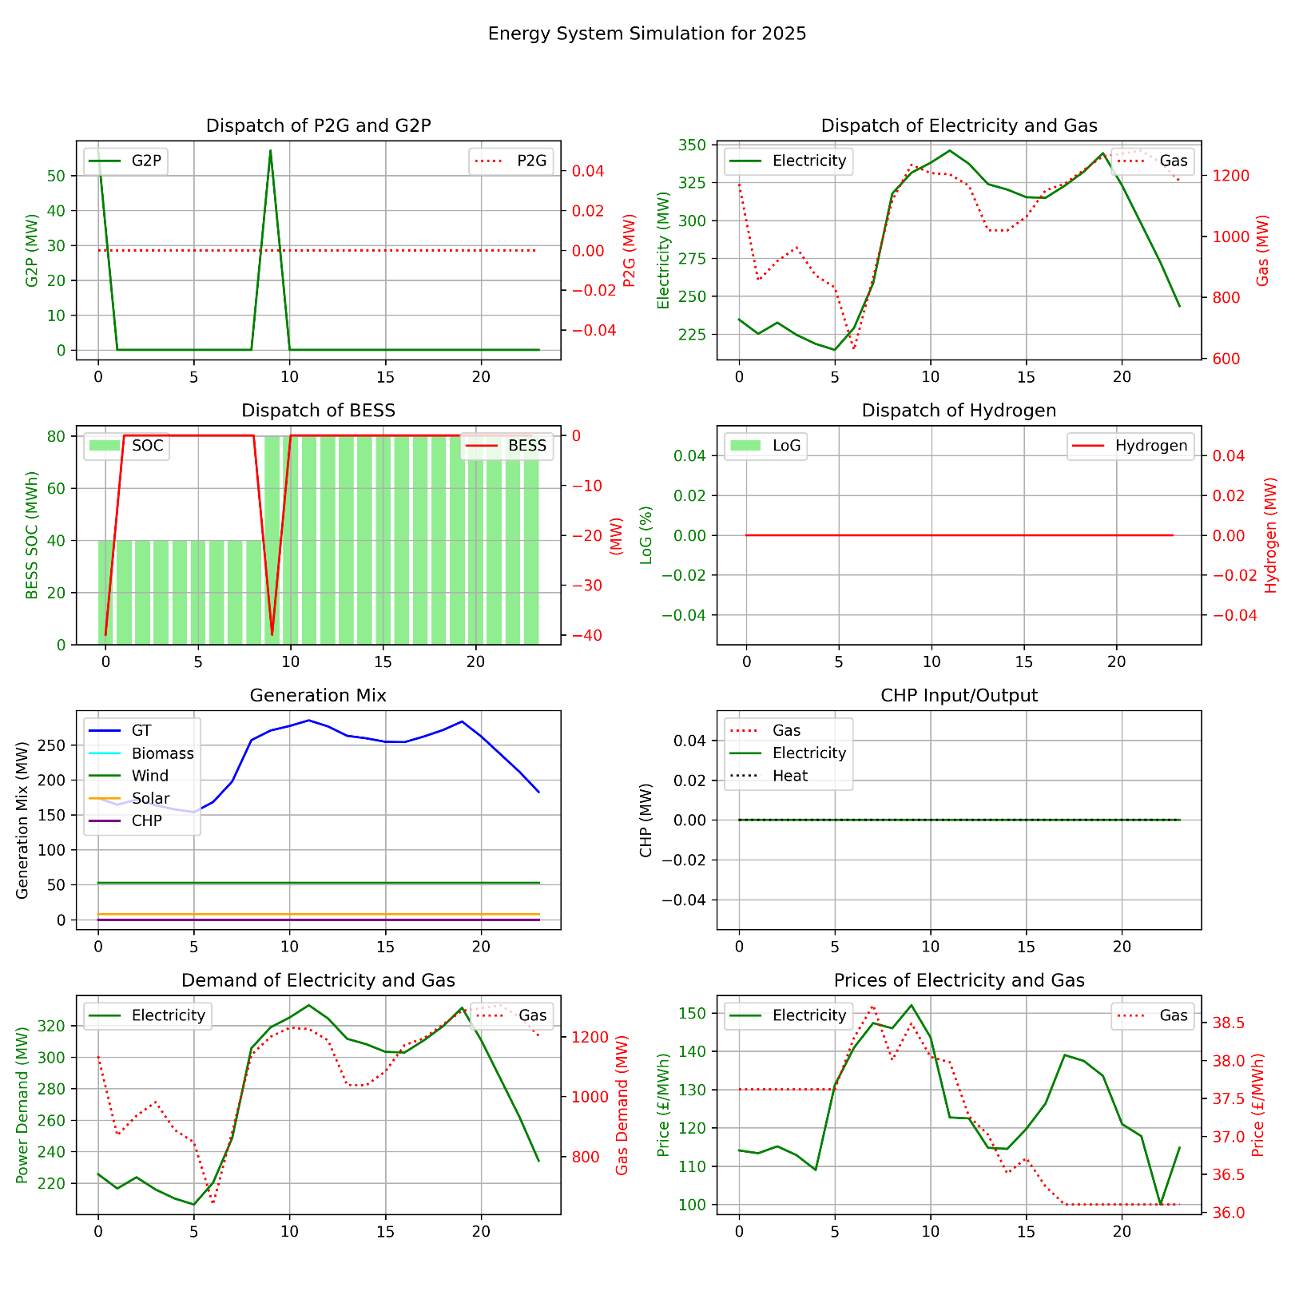
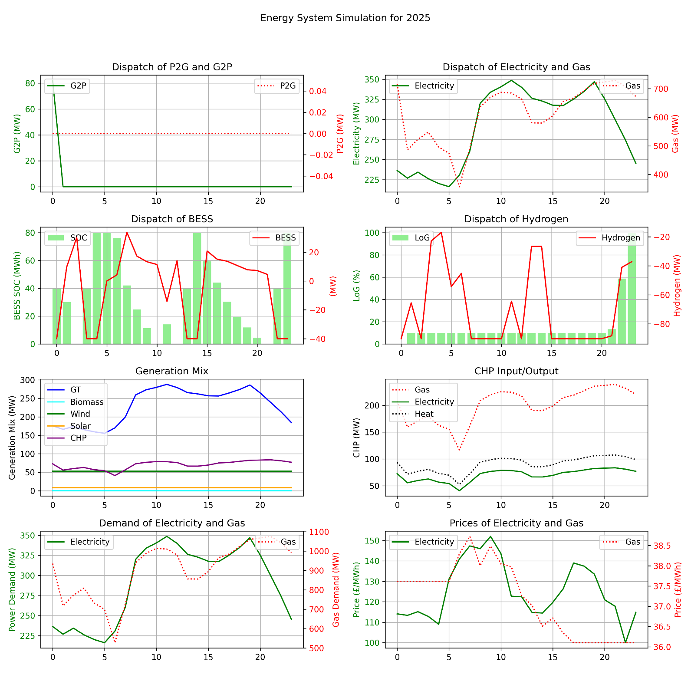
Heat Decarbonisation: North of Tyne (NoT)
Case Study
1) Analysis the economic dispatch for the base case (without interventions) and Monte Carlo simulation of the social and technical interventions.
(Base Case)
(Monte Carlo Simulation of Interventions)
BESS:
(Positive) Discharging,
(Negative) Charging.
Hydrogen:
(Positive) Fuel Cell,
(Negative) Electrolyser.
Electricity (G2P), Gas (P2G):
(Positive) Utilize or Importing,
(Negative) Export.

Slide 8
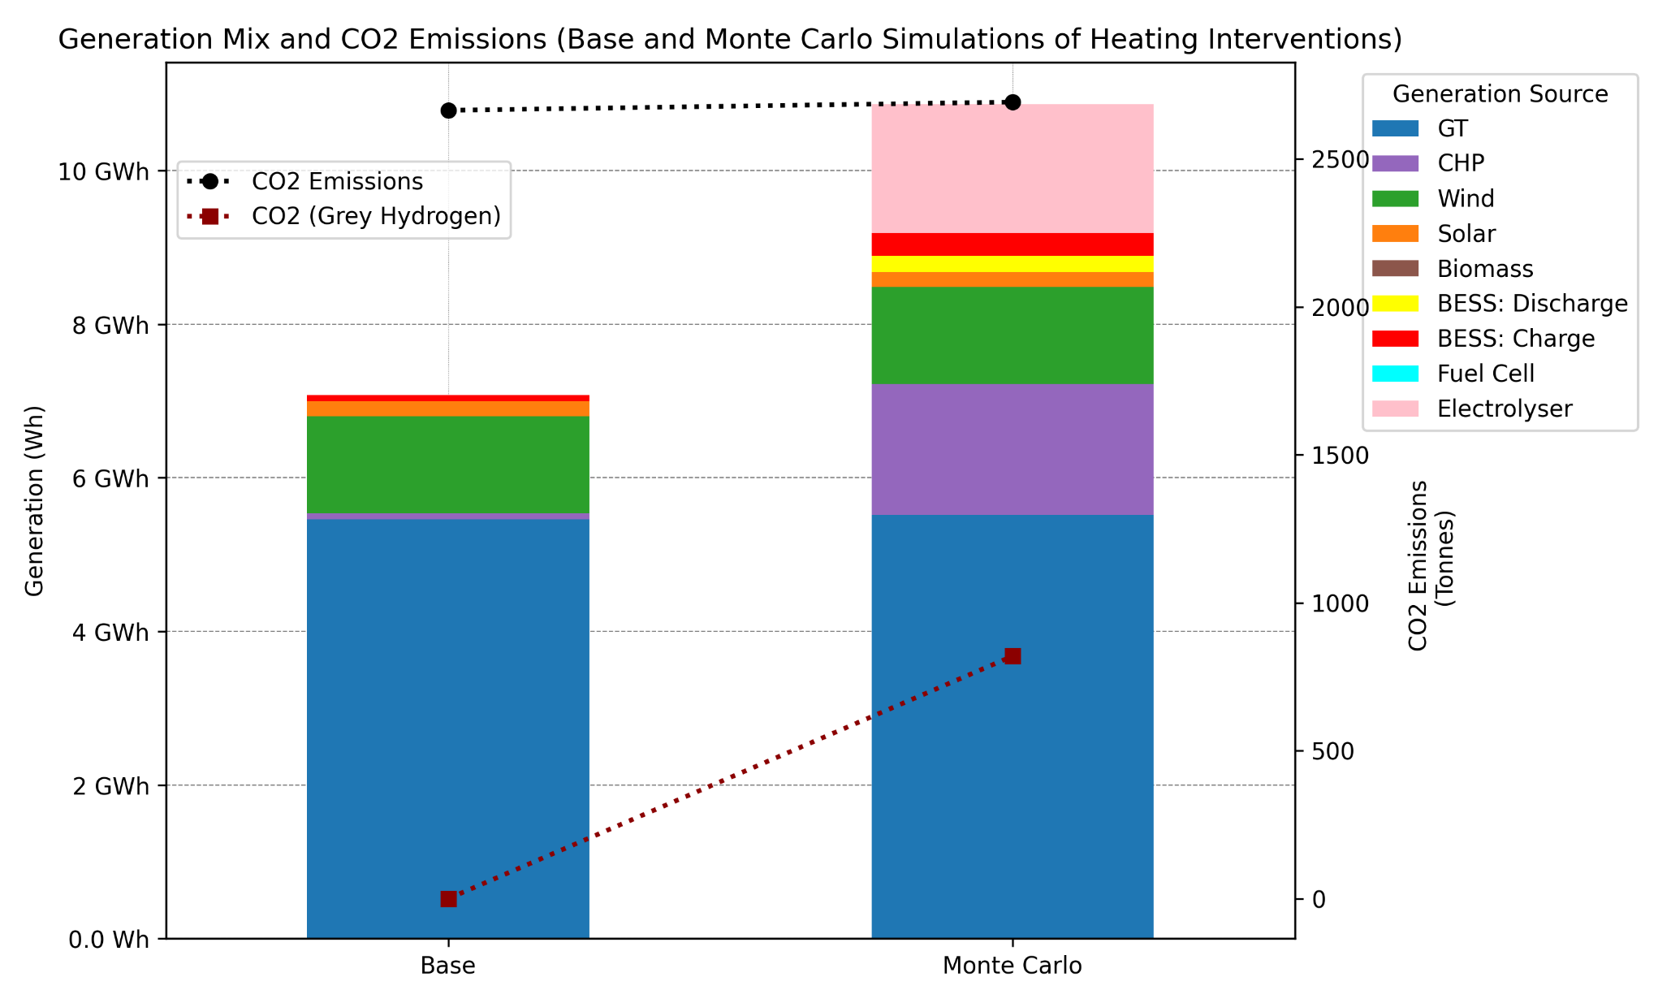
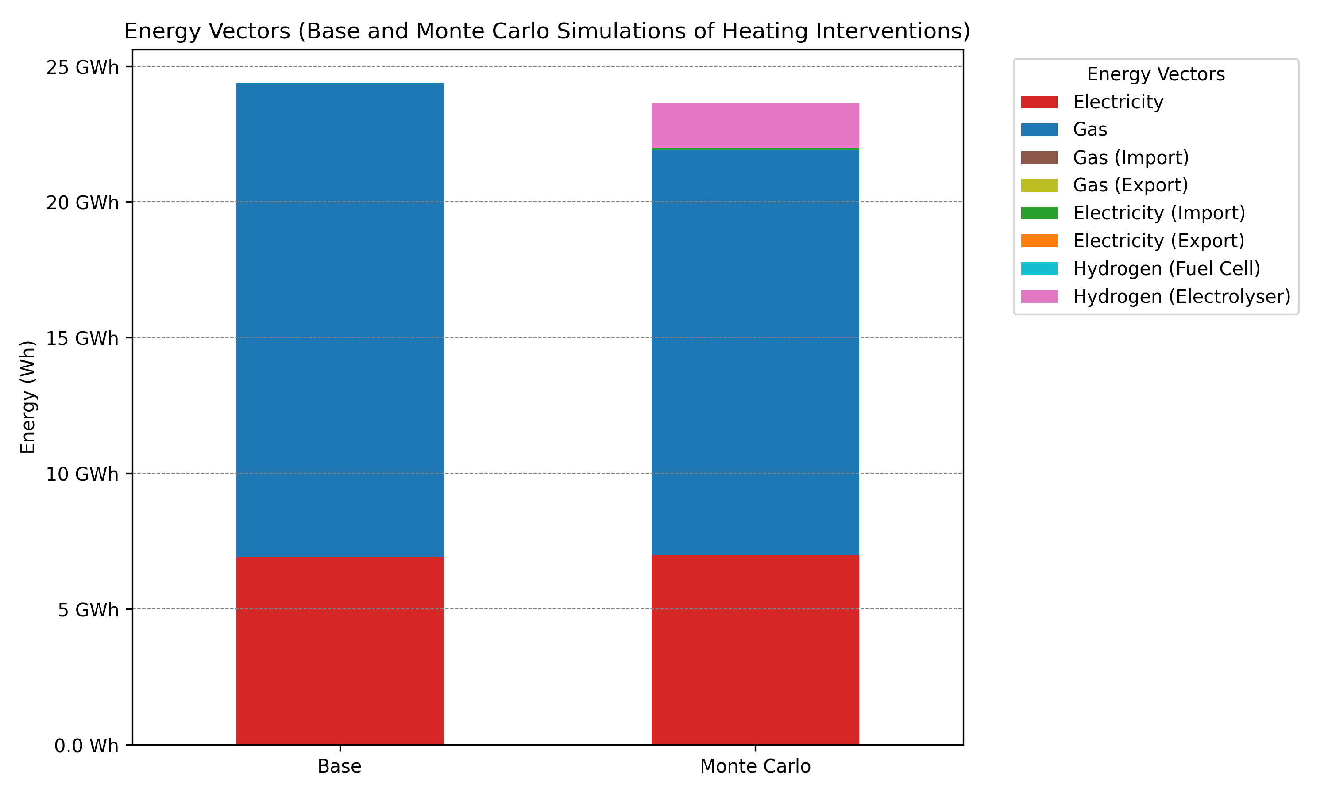
Heat Decarbonisation: North of Tyne (NoT)
Case Study
2) Investigating the impacts social and technical interventions on the supply side for both cases: (A) Base (without interventions) and (B) Monte Carlo simulation for heating interventions.
Note: The energy and emissions of hydrogen production are included in the model.
CO2 Emissions ➔ CO₂ emissions is system-wide emissions, and the hydrogen is green.
CO2 (Grey Hydrogen) ➔ CO₂ emissions from producing grey hydrogen only.
(Generation Mix: (A) Base and (B) Interventions cases)
(Energy Vectors: (A) Base and (B) Interventions cases)

Slide 9
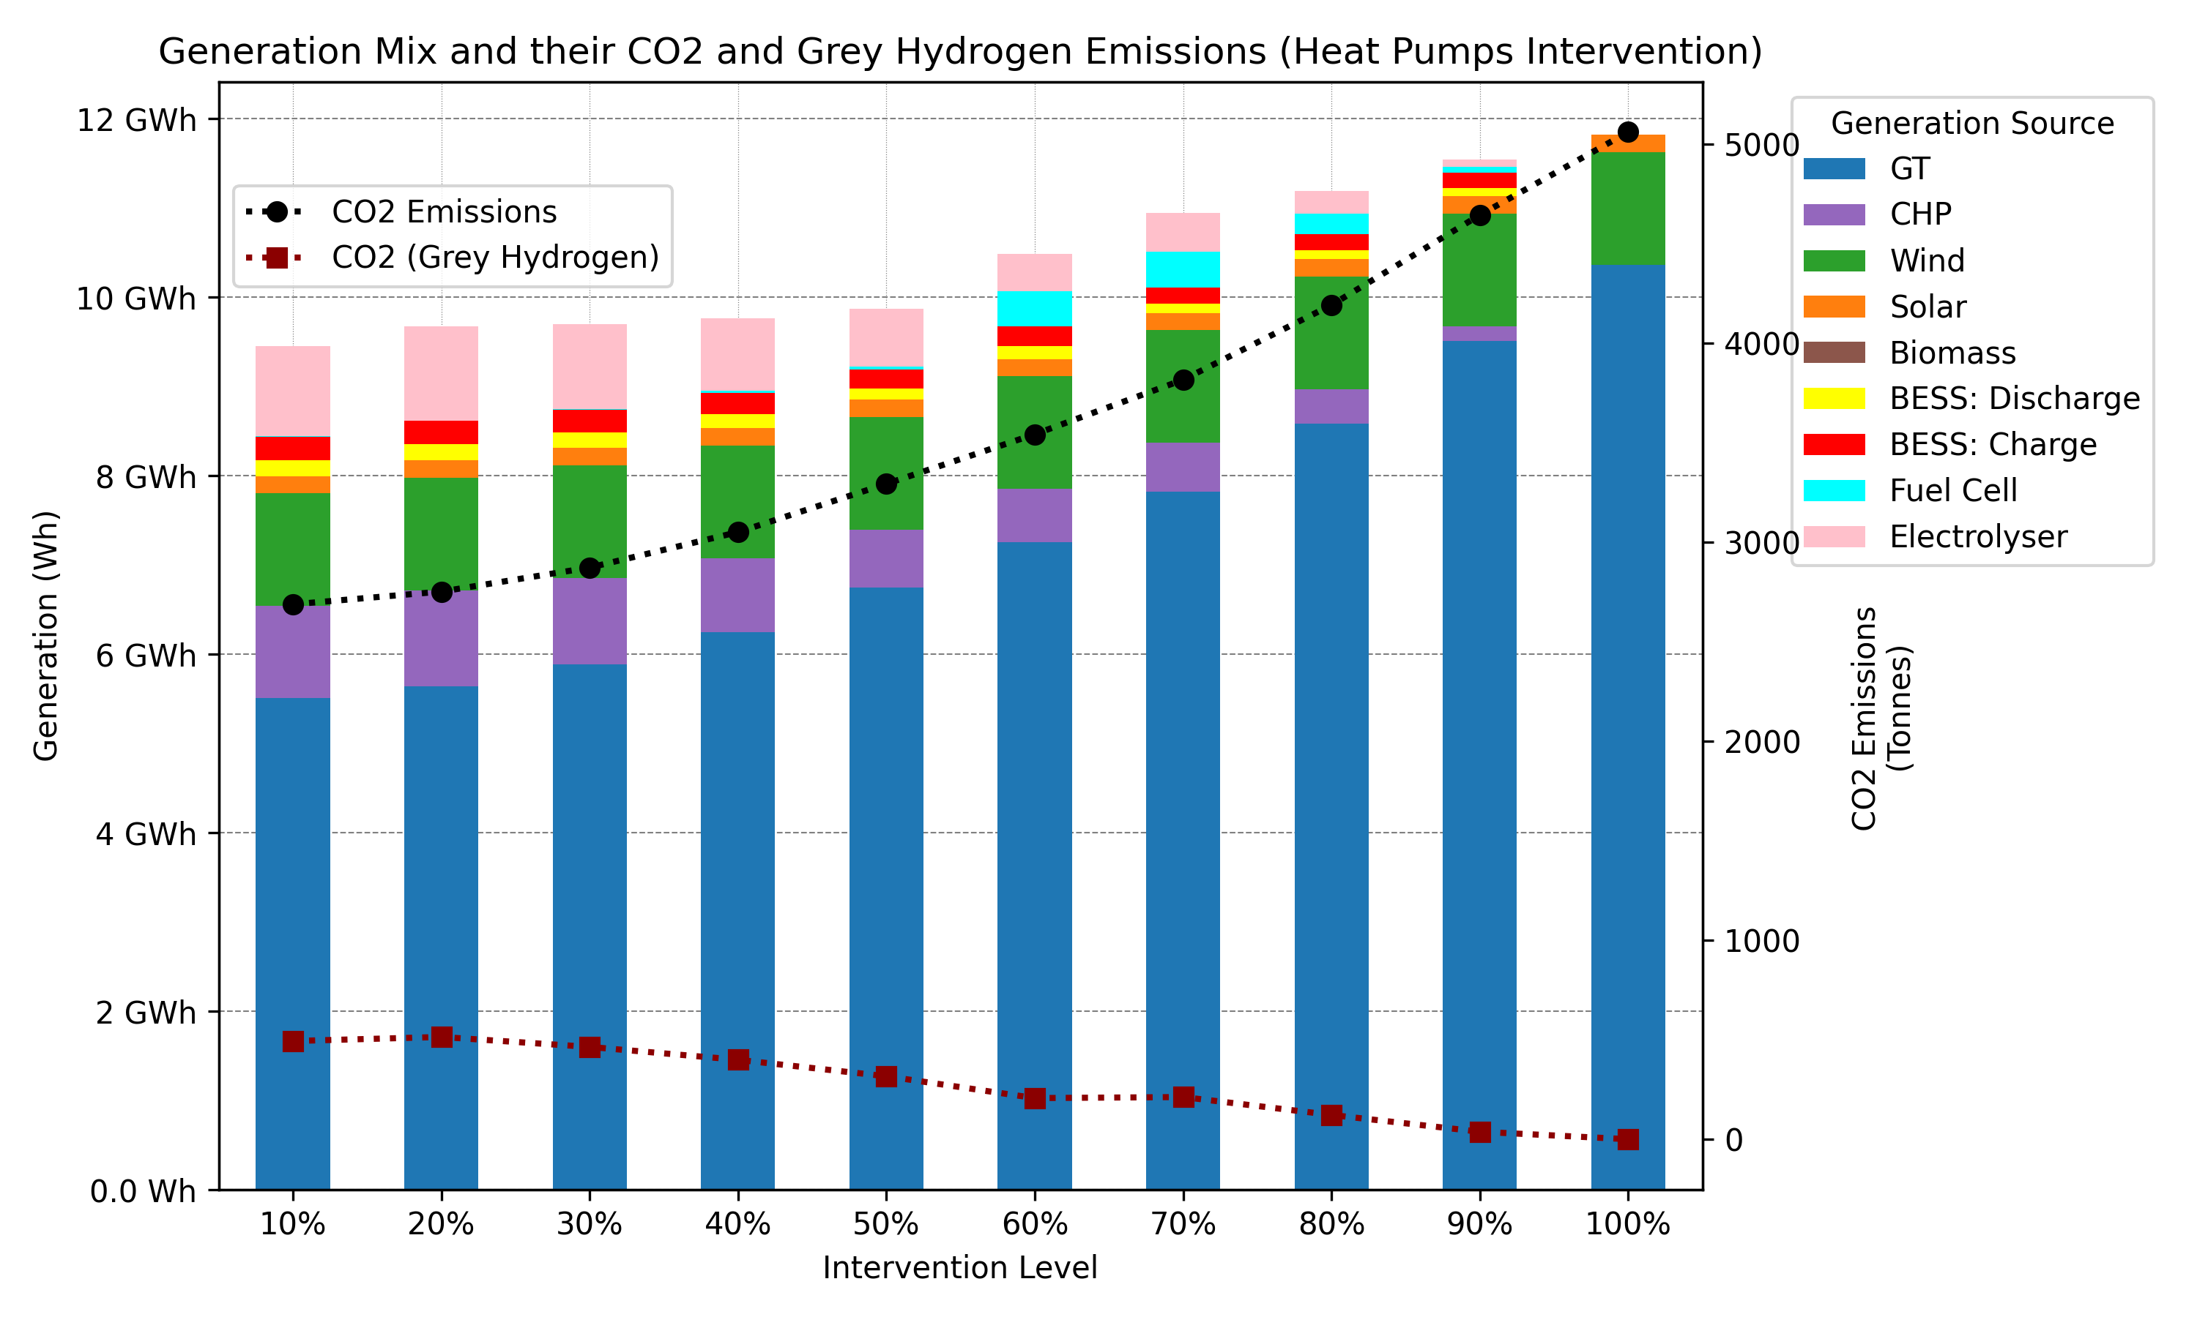
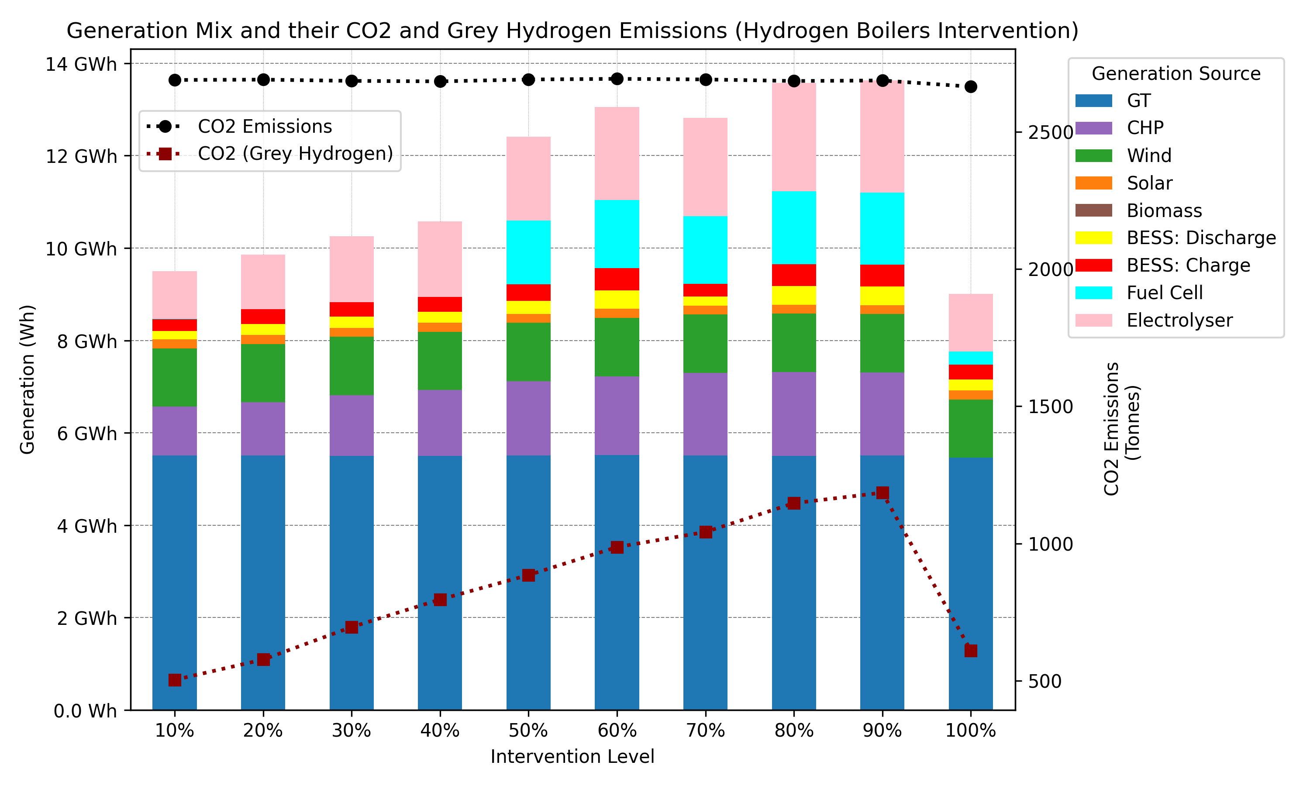
Heat Decarbonisation: North of Tyne (NoT)
Case Study
3) Investigating the impacts heat pumps and hydrogen boilers with different interventions levels (10% - 50%) separately.
Other social-technical interventions complete the remaining heating demand.
Note: In consideration of customer comfort and affordability, we focus more on technical interventions, such as heat pumps and hydrogen boilers.
The share of heat energy from CHP is excluded when the intervention consists entirely of heat pumps or hydrogen boilers (@ 100%).
(Heat Pumps Interventions)
(Hydrogen Boilers Interventions)

Slide 10
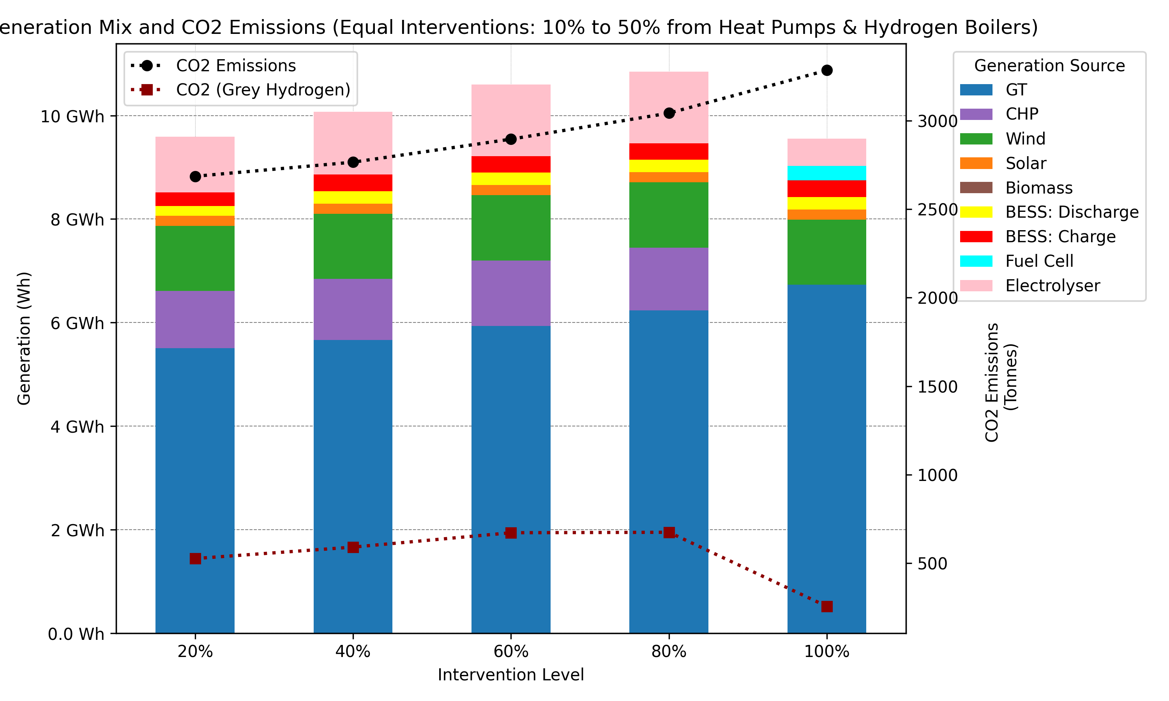
Heat Decarbonisation: North of Tyne (NoT)
Case Study
4) Investigating the impacts heat pumps and hydrogen boilers with different interventions levels (10% - 50%) for each.
Other social-technical interventions complete the remaining heating demand, except when HPs=50% and HBs=50%.
Note: The share of heat energy from CHP is excluded when the intervention consists entirely of heat pumps or hydrogen boilers (@ 100%).
Heat Pumps and Hydrogen Boilers interventions with equal shares (10% - 50%) for each

Slide 11
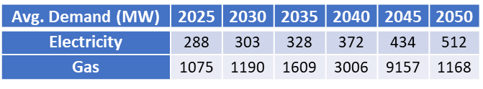
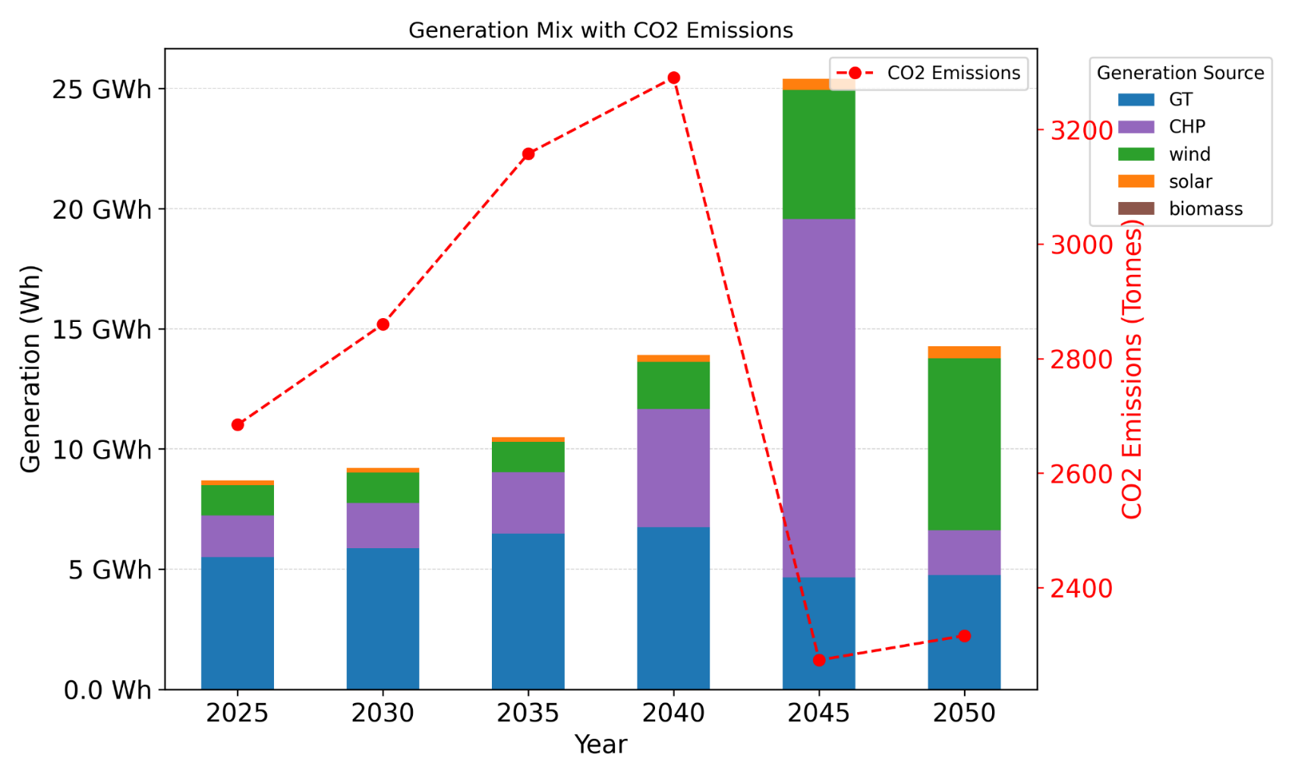
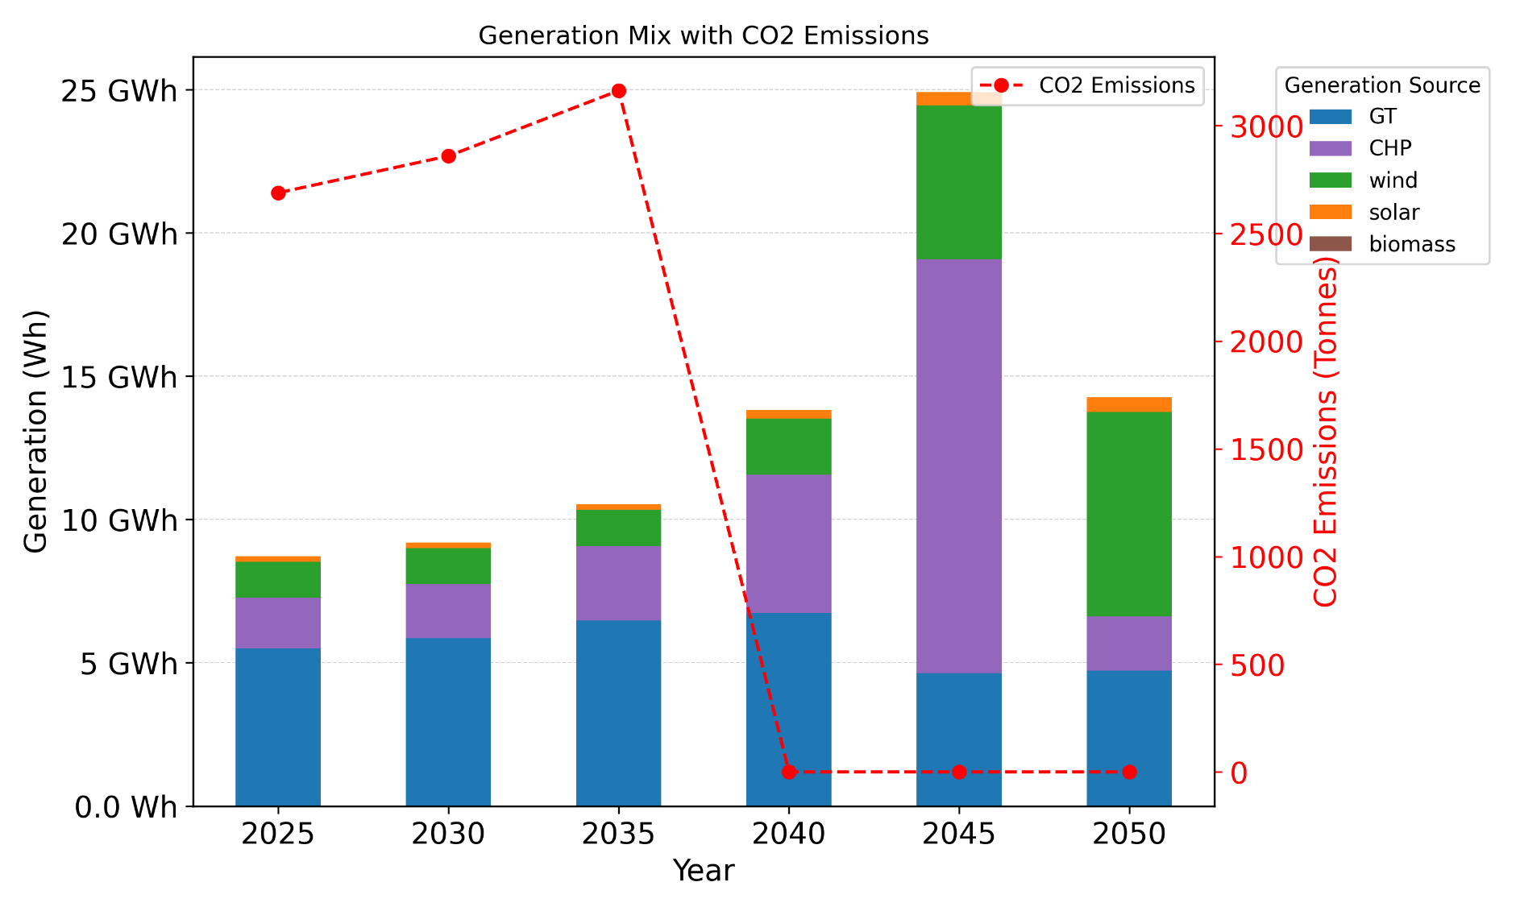
Heat Decarbonisation: North of Tyne (NoT)
Case Study
5) Economic planning for one day heating demand from Monte Carlo simulated social and technical interventions with level equal share for each intervention. Planning years are 2025 to 2050, so the economic dispatch of one day is planned in each year.
Note: To match with the future energy supply installations, the day demand is scaled by the trend of demand change according to the (FS) scenario in Energy Future Scenarios from National Grid.
(A) Without CCS deployment
(B) With CCS deployment, from 2040 to 2050

Slide 12
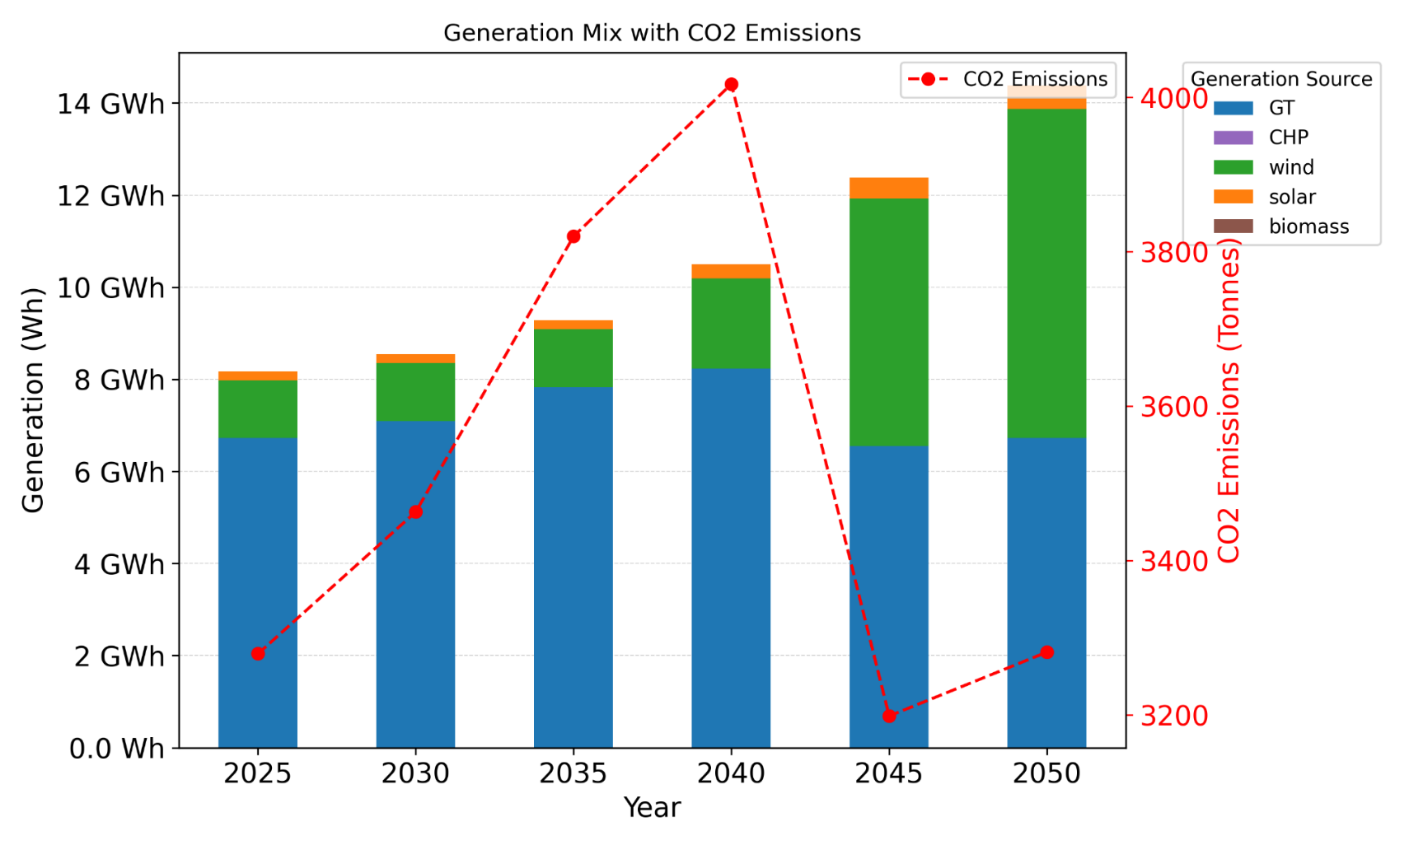
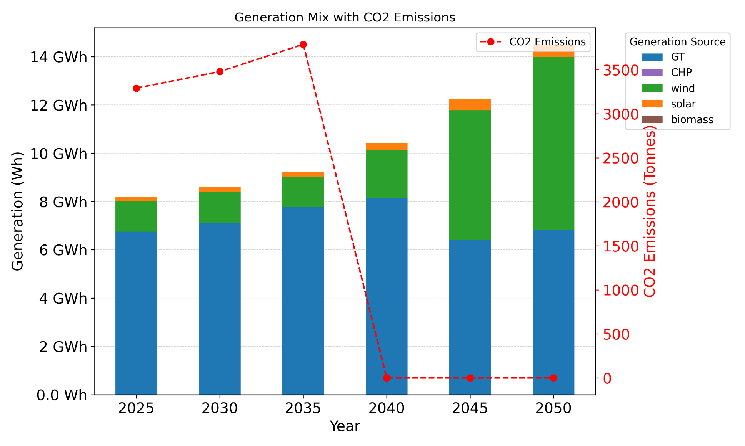
Heat Decarbonisation: North of Tyne (NoT)
Case Study
6) Economic planning for one day with heating interventions 50% of heat pumps and 50% hydrogen boilers (2025 - 2050).
(A) Without CCS deployment
(B) With CCS deployment, from 2040 to 2050

Slide 13
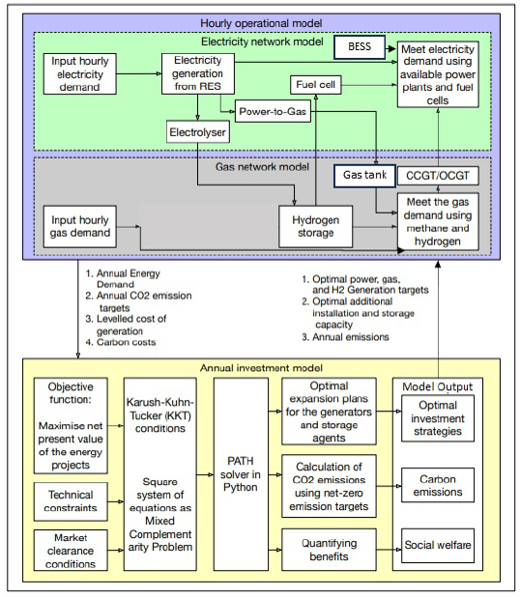
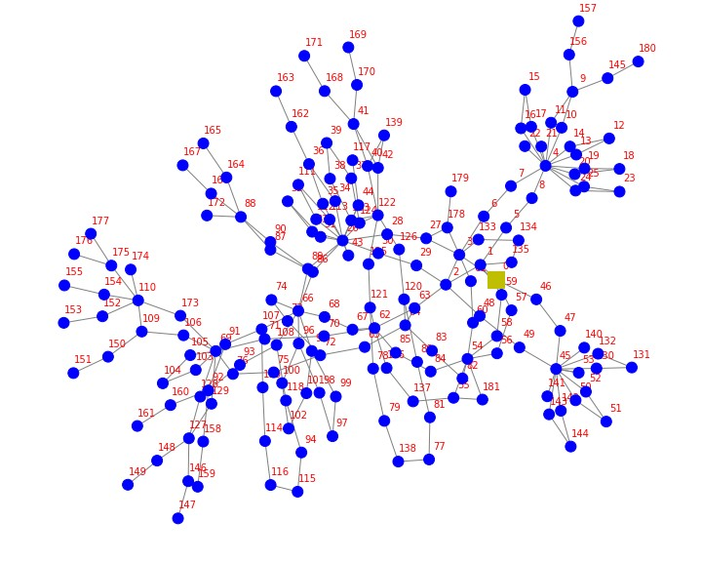
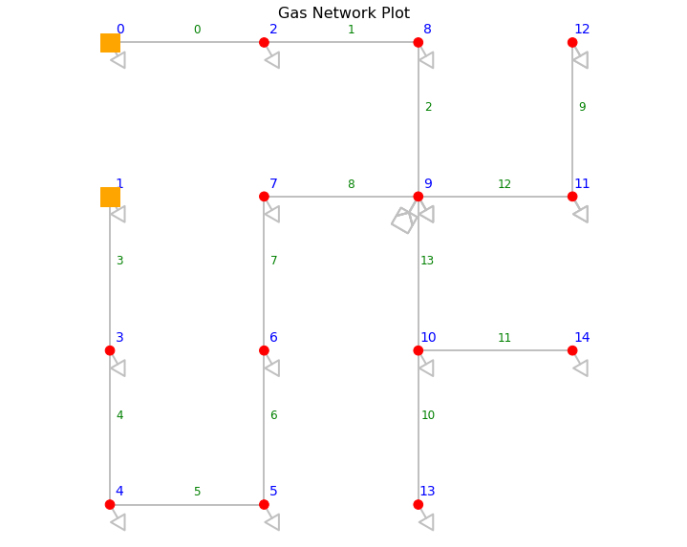
Heat Decarbonisation: North of Tyne (NoT)
Case Study
7) Economic planning for one day with hydrogen blending into the existing natural gas network
Combining Game-Theory model with OPGF model
GT model output ➔ OPGF output ➔ GT model
Electricity Network
Gas Network
Schematic Diagram of Game-Theoretic Model
Short-term operation & long term planning

Slide 14
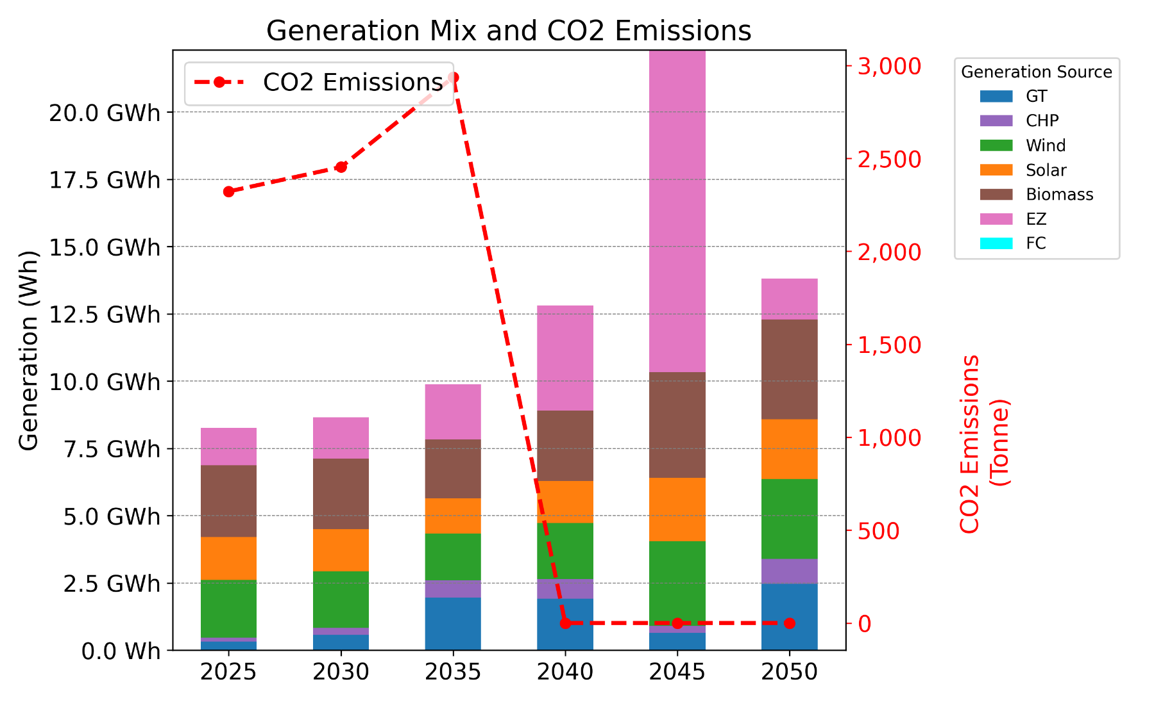
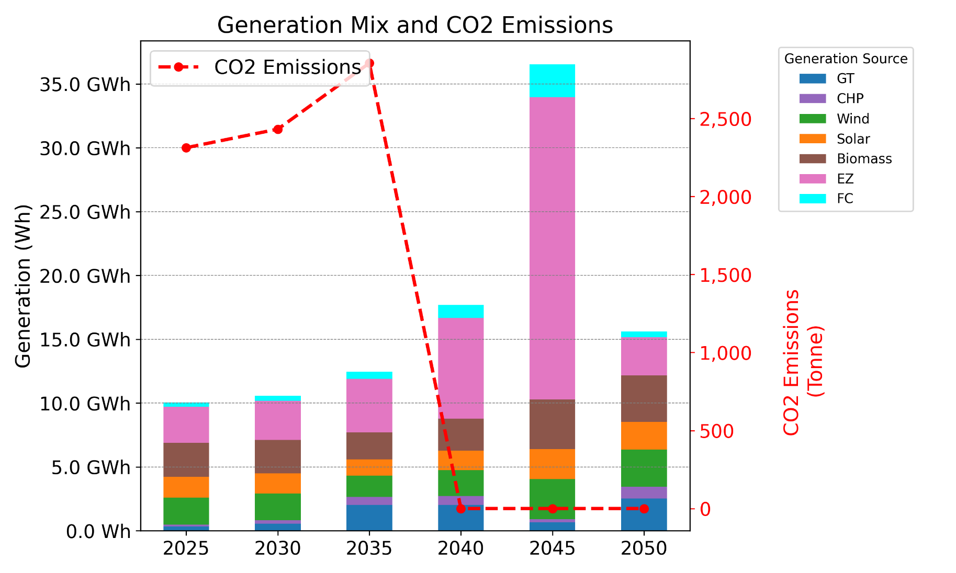
Heat Decarbonisation: North of Tyne (NoT)
Case Study
7.1) Economic planning with hydrogen blending for one day with heating demand from Monte Carlo simulated social and technical interventions with level equal share for each intervention.
Electrolyser (EZ) ➔ Hydrogen Boiler ≥ EZ ≥ Hydrogen Blending
Fuel Cell (FC) ➔ 0 ≥ EZ ≥ (Hydrogen Blending - Hydrogen Boiler)
Hydrogen Blending = 10 % into the gas network,
with CCS deployment (2040 to 2050) and unlimited Renewables
(B) Hydrogen Blending = 20 % into the gas network,
With CCS deployment (2040 to 2050) and unlimited Renewables

Slide 15
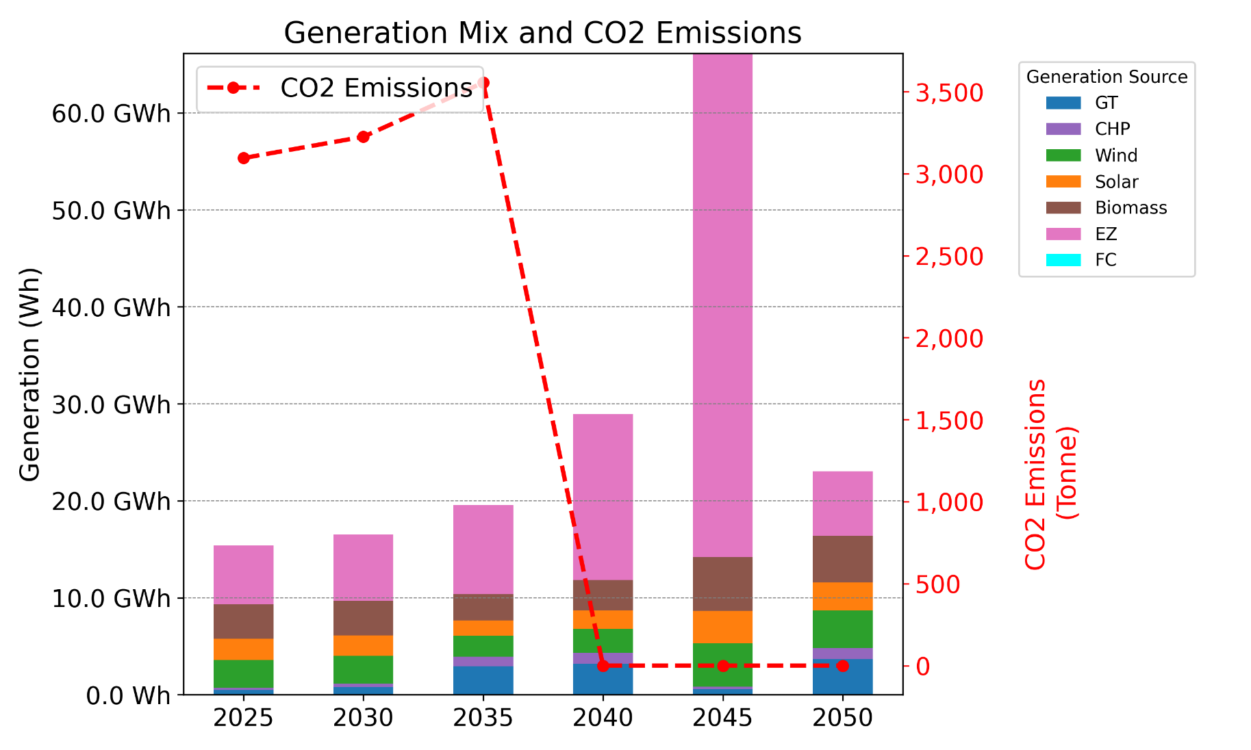
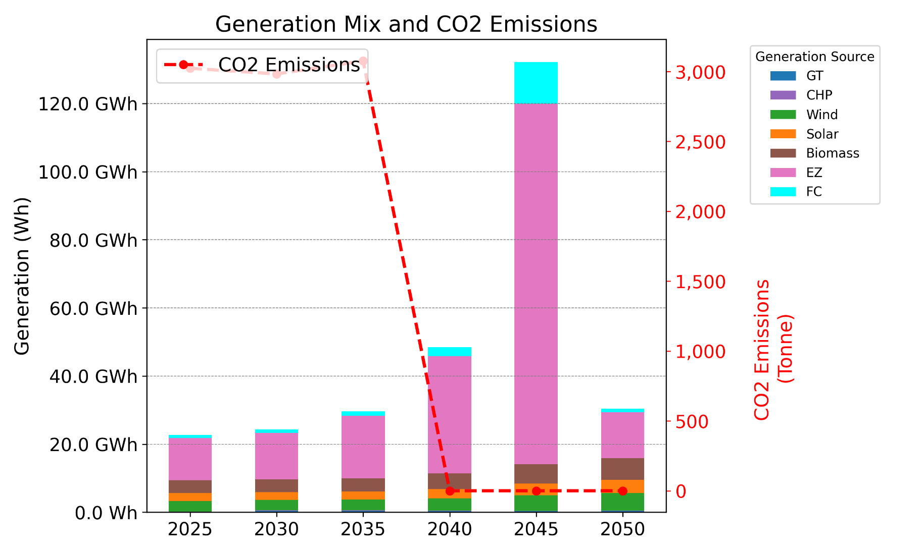
Heat Decarbonisation: North of Tyne (NoT)
Case Study
7.2) Economic planning for one day with heating interventions 50% of heat pumps and 50% hydrogen boilers (2025 - 2050).
Electrolyser (EZ) ➔ Hydrogen Boiler ≥ EZ ≥ Hydrogen Blending
Fuel Cell (FC) ➔ 0 ≥ EZ ≥ (Hydrogen Blending - Hydrogen Boiler)
Hydrogen Blending = 50 % into the gas network,
with CCS deployment (2040 to 2050) and unlimited Renewables
(B) Hydrogen Blending = 100 % into the gas network,
with CCS deployment (2040 to 2050) and unlimited Renewables

Slide 16
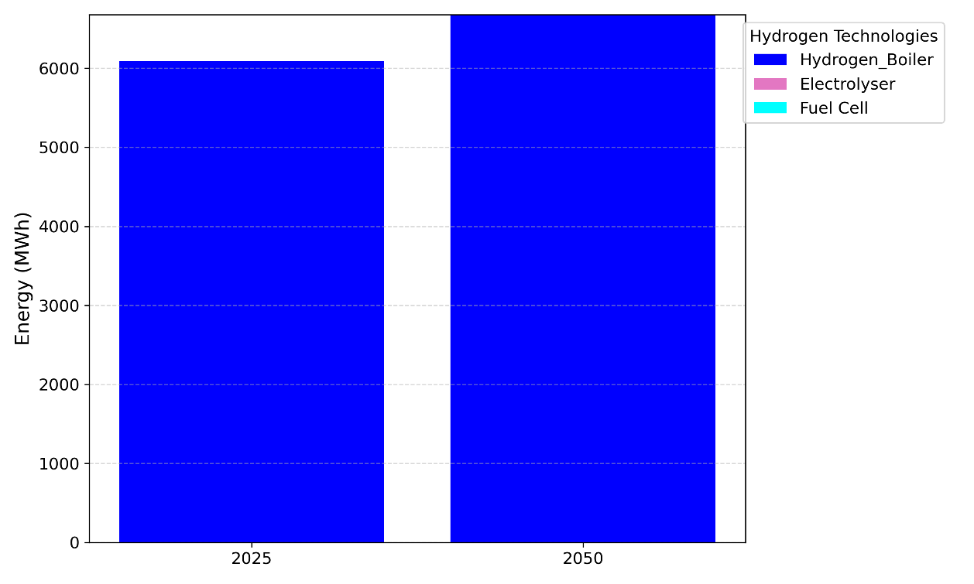
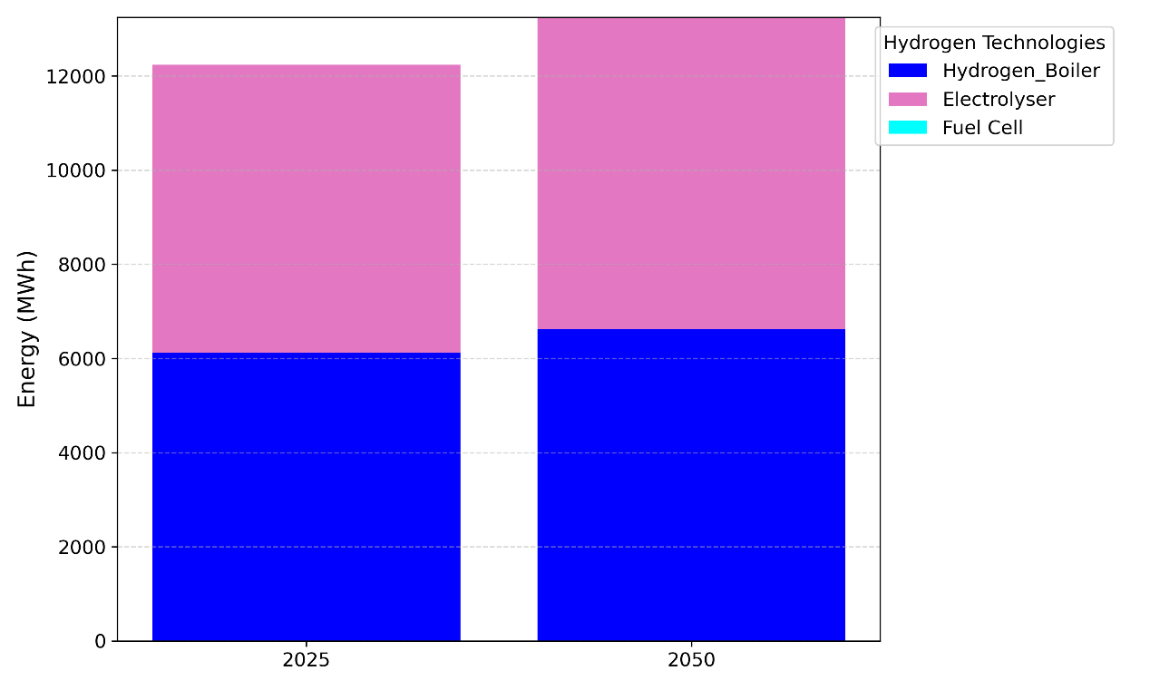
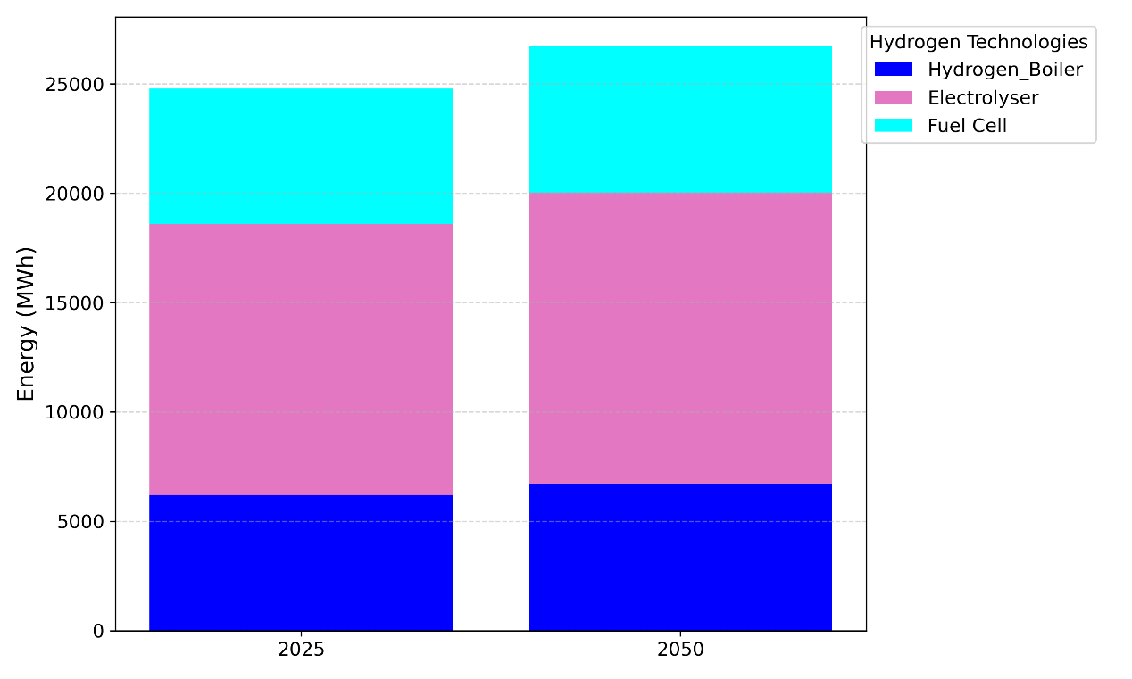
Heat Decarbonisation: North of Tyne (NoT)
Case Study
7.2) Economic planning for one day with heating interventions 50% of heat pumps and 50% hydrogen boilers (2025 & 2050).
**Energy Mix of the Hydrogen Technologies:
(A) Hydrogen Blending = 10 %
(A) Hydrogen Blending = 20 %
(A) Hydrogen Blending = 100 %

Slide 17
Heat Decarbonisation: North of Tyne (NoT)
Conclusion
The system-wide modeling approach for residential heating in the NoT region demonstrates that while the applied social and technical interventions effectively reduce gas demand, their impact on overall CO₂ emissions remains limited with the existing system infrastructure.
Prioritising solutions that minimise lifestyle and cost impacts for residents is vital for supporting heat decarbonisation efforts.
The significant gap between gas and electricity demand during peak heating periods indicates the need for substantial infrastructure upgrades to support low-carbon technologies, such as renewables, heat pumps, and hydrogen boilers.
In the NoT region, Carbon Capture and Storage (CCS) technology could play an important role as an effective option to decarbonise residential heating demand.
Additionally, hydrogen blending into the gas network could help in reducing the emissions while still meeting heating demand.

Slide 18
Thank you for your attention

